Slide 1



Sync 1.1 Welcome to the course!
UHC Summer Institute- June 26-30, 2023
Ran Li, Ms
Ana Ortigoza, MD PhD

Slide 2
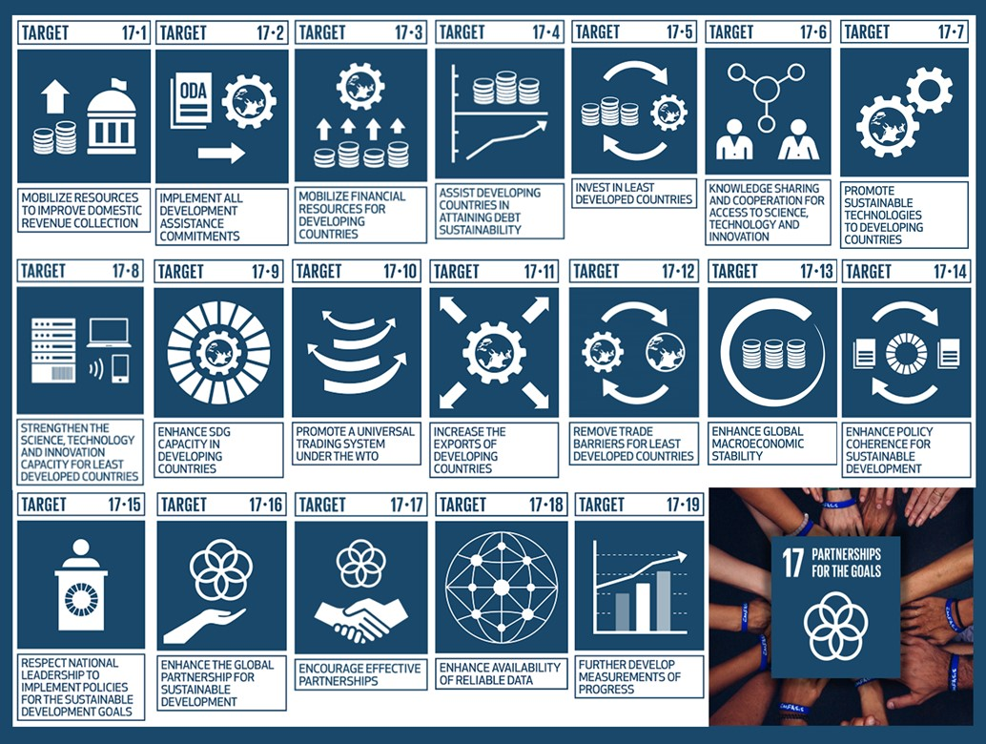
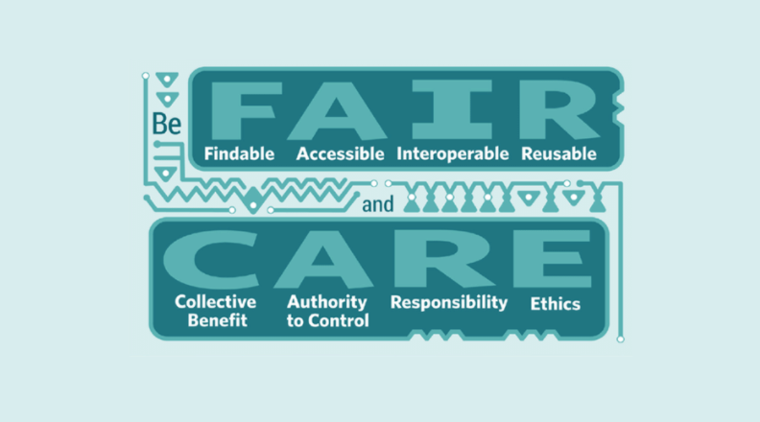
the importance of FAIR data for society

Slide 3
the importance of FAIR data for society

Slide 4
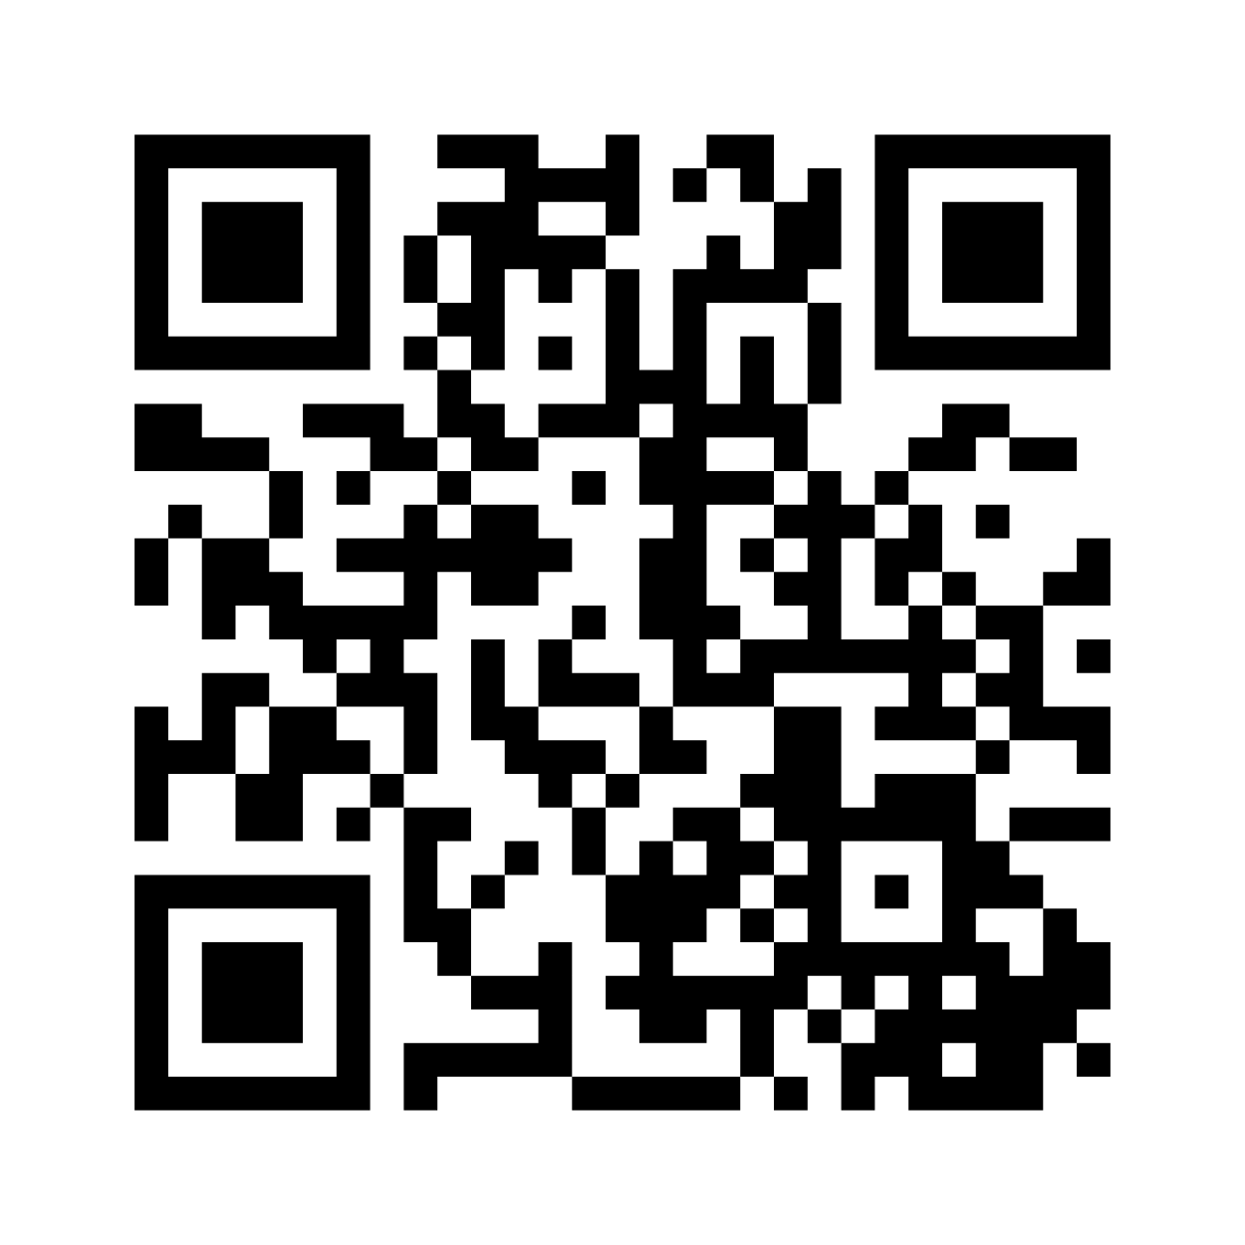
Why do you think FAIR principles are important?
https://www.menti.com/al366nhuwx9e
Notes:
Mentimeter link
https://www.menti.com/al366nhuwx9e

Slide 5
How do you see the FAIR principles connects to your everyday work?
https://www.menti.com/al366nhuwx9e
Notes:
Mentimeter link
https://www.menti.com/al366nhuwx9e

Slide 6
→ Time for Sync 2.2 →

